Slide 1
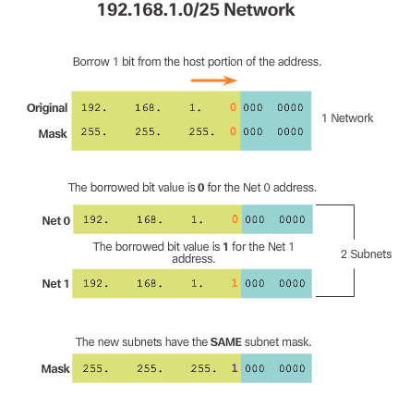
Classless Subnetting Example
Notes:
8.1.2.6 Classless Subnetting Example

Slide 2
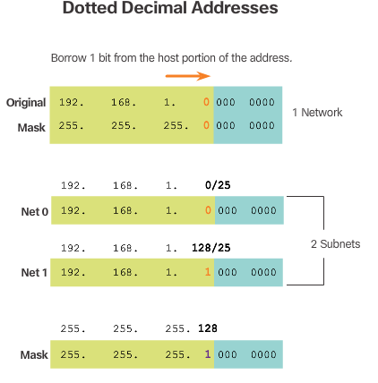
Classless Subnetting Example (cont.)
Notes:
8.1.2.6 Classless Subnetting Example (Cont.)

Slide 3
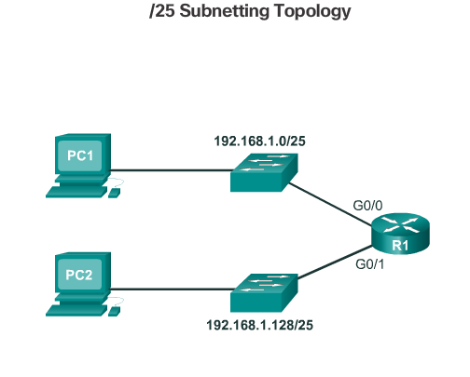
Creating 2 Subnets
Notes:
8.1.2.7 Creating 2 Subnets

Slide 4
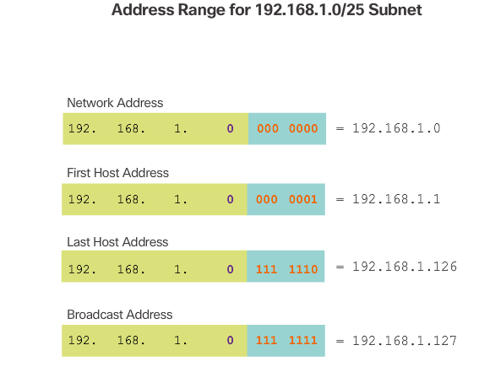

Creating 2 Subnets (cont.)
Notes:
8.1.2.7 Creating 2 Subnets (Cont.)

Slide 5
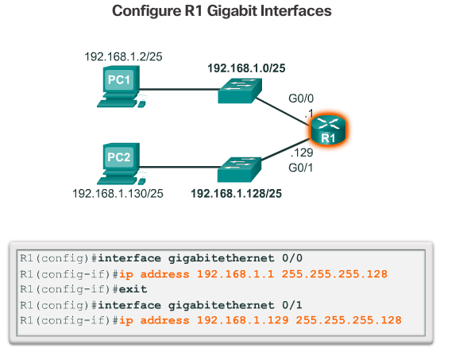
Creating 2 Subnets (cont.)
Notes:
8.1.2.7 Creating 2 Subnets (Cont.)

Slide 6
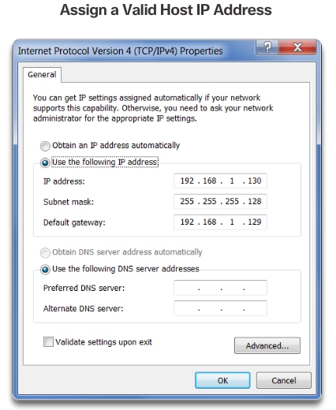
Creating 2 Subnets (cont.)
Notes:
8.1.2.7 Creating 2 Subnets (Cont.)
8.1.2.8 Video Demonstration – Creating Two Equal-Sized Subnets

Slide 7
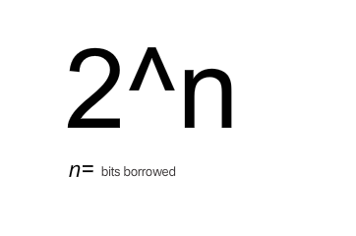
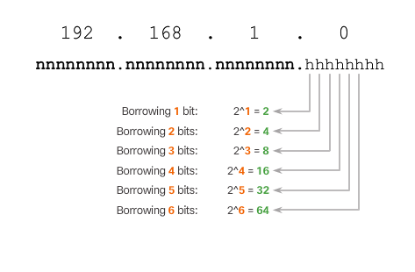
Subnetting Formulas
To calculate the number of subnets.
Notes:
8.1.2.9 Subnetting Formulas

Slide 8
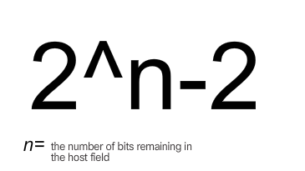
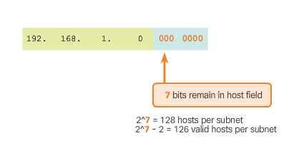
Subnetting Formulas (cont.)
To calculate the number of hosts.
Notes:
8.1.2.9 Subnetting Formulas (Cont.)

Slide 9
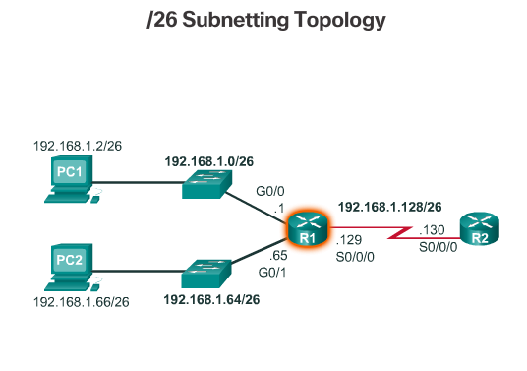
Creating 4 Subnets
Notes:
8.1.2.10 Creating 4 Subnets

Slide 10
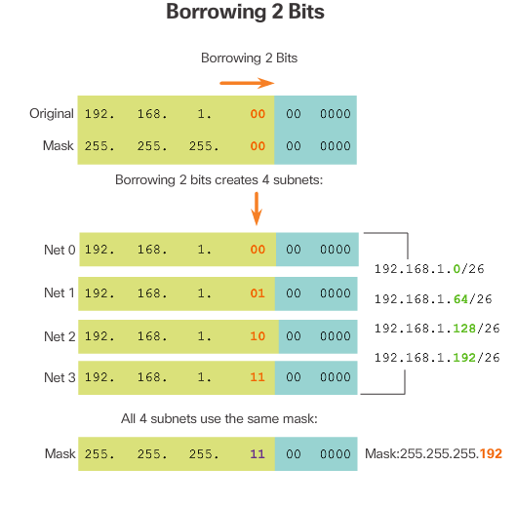
Creating 4 Subnets (cont.)
Notes:
8.1.2.10 Creating 4 Subnets (Cont.)

Slide 11
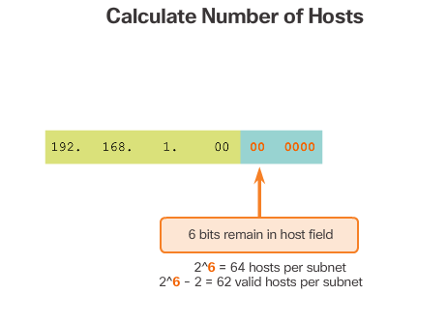
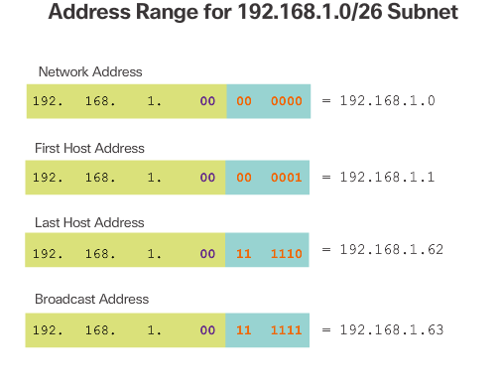
Creating 4 Subnets (cont.)
Notes:
8.1.2.10 Creating 4 Subnets (Cont.)

Slide 12
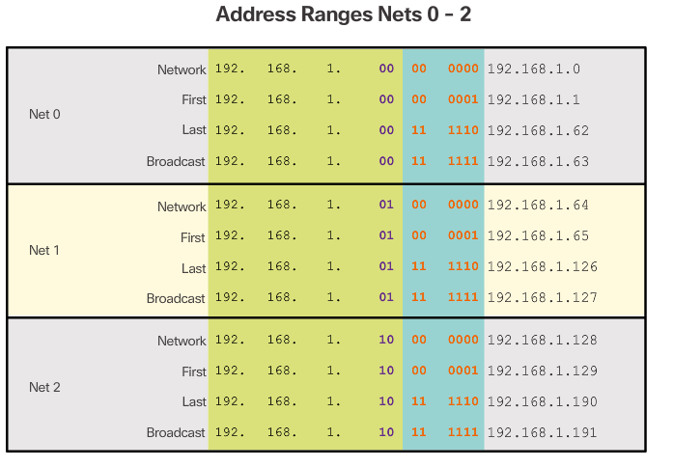
Creating 4 Subnets (cont.)
Notes:
8.1.2.10 Creating 4 Subnets (Cont.)

Slide 13
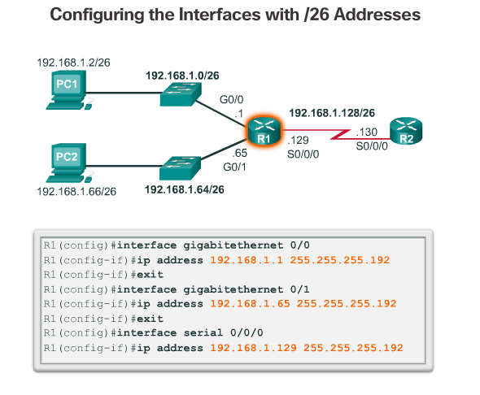
Creating 4 Subnets (cont.)
Notes:
8.1.2.10 Creating 4 Subnets (Cont.)
8.1.2.11 Video Demonstration – Creating Four Equal-Sized Subnets
8.1.2.12 Video Demonstration – Creating Eight Equal-Sized Subnets

Slide 14
Subnetting a /16 and a /8 Prefix

Slide 15
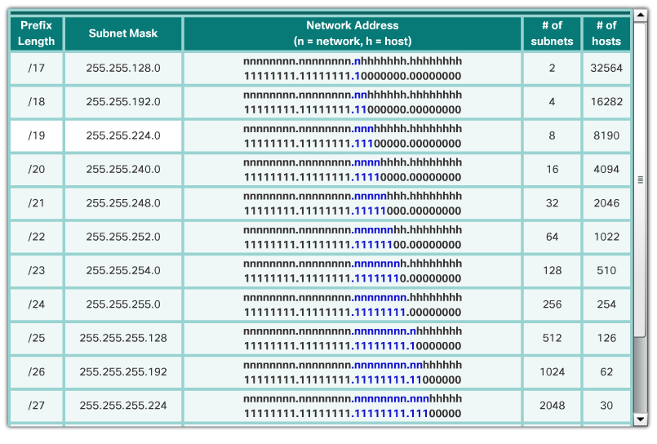
Creating Subnets with a /16 prefix
Notes:
8.1.3.1 Creating Subnets with a /16 prefix

Slide 16
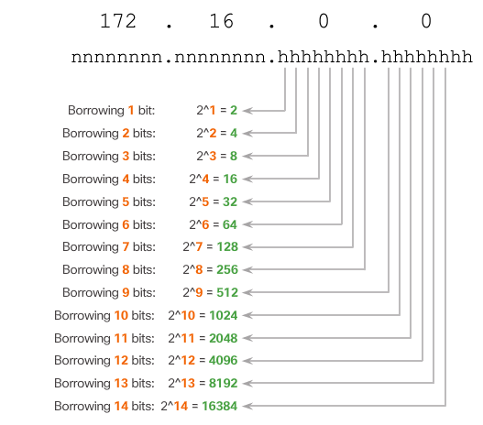
Creating 100 Subnets with a /16 Network
Notes:
8.1.3.2 Creating 100 Subnets with a /16 Network

Slide 17
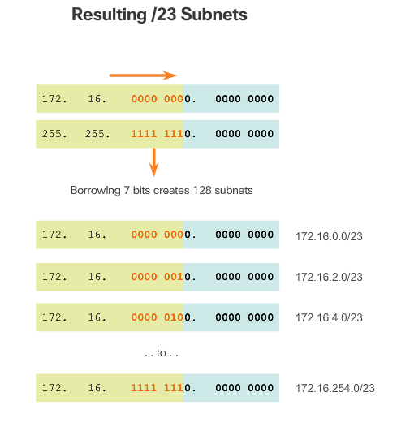
Creating 100 Subnets with a /16 Network (cont.)
Notes:
8.1.3.2 Creating 100 Subnets with a /16 Network

Slide 18
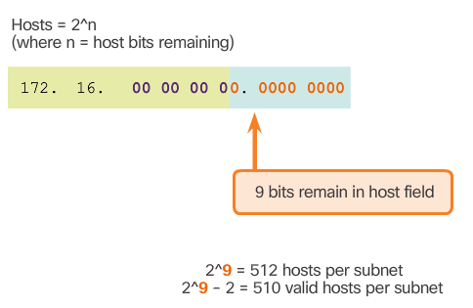
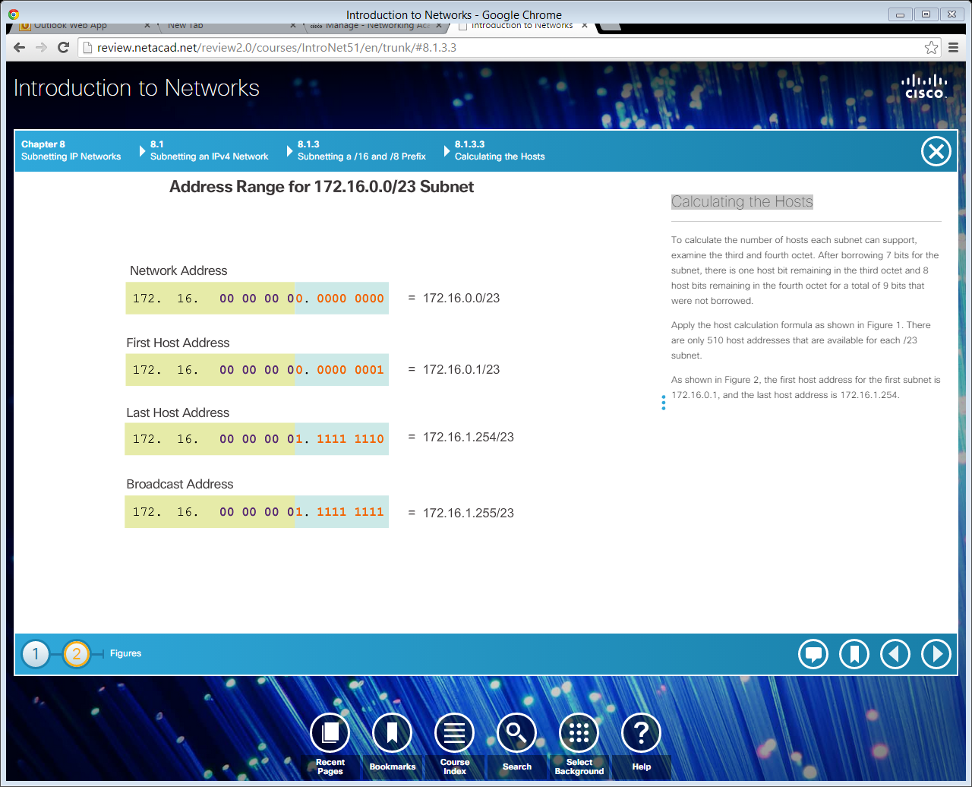
Calculating the Hosts
Notes:
8.1.3.3 Calculating the Hosts
8.1.3.4 Video Demonstration – Creating One Hundred Equal-Sized Subnets

Slide 19
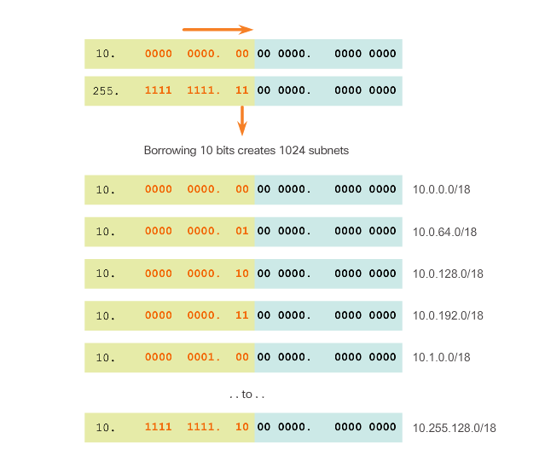
Creating 1000 Subnets with a /8 Network
Notes:
8.1.3.5 Creating 1000 Subnets with a /8 Network

Slide 20
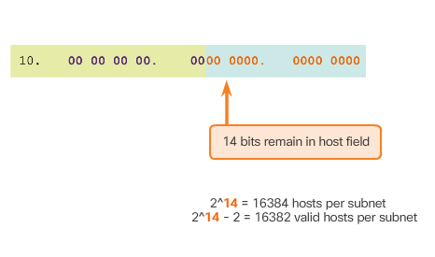
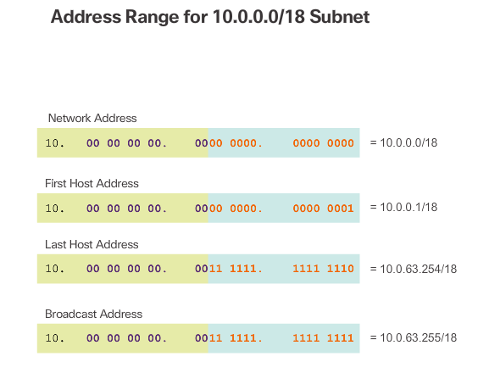
Creating 1000 Subnets with a /8 Network (cont.)
Calculating Hosts
Notes:
8.1.3.5 Creating 1000 Subnets with a /8 Network (Cont.)
8.1.3.6 Video Demonstration – Subnetting Across Multiple Octets

